Slide 1

Research Paper Writing

Slide 2
Before you begin working on a research paper in any course, it is important to understand what a research paper is not.
A research paper is not "about" a subject A research paper should have a thesis -- a clear point of view. It is not simply a generalized discussion of an issue.
A research paper is not a summary of everything you can find Your goal is not to collect everything you can find out about a subject and summarize it. Although you should review as much material as possible, you should select sources that directly support your thesis.
A research paper is not a list of quotes The focus of your paper is your point of view, your commentary. Direct quotations, facts, and statistics may be woven throughout your paper, but they should support your position. Your commentary should do more than simply introduce or link quotations.
A research paper does not support a pre-conceived point of view Looking up facts that support what you already believe is not genuine research. You should examine evidence then form an opinion.
A research paper does not present the ideas of others without documentation Research papers must use documentation methods to prevent you from plagiarizing sources. Do not borrow ideas, statistics, or facts without noting their original source.

Slide 3
A research paper, no matter what the subject, must achieve specific goals:
A research paper meets the needs of the assignment Many instructors give specific requirements for research papers, detailing topics, use of sources, and documentation methods.
o Make sure you fully understand the scope of the assignment.
o Keep the needs of the assignment in mind as you work on your paper. Constantly refer to the instructor's guidelines to keep your research on track.
A research paper has a clear focus The more you narrow down your subject, the easier your paper will be to write. It is better to write about one character in a novel or a play than attempt to comment on an entire work. It is easier to focus on one treatment for a single psychiatric disorder than trying to address mental health.
A research paper has a clear thesis A research paper must express a point of view, not simply report on the ideas of others. The focus of the paper is not the views of others but your opinions and interpretations.
A research paper comments on the quantity and quality of sources A research paper does not simply summarize and present the ideas of others. A good research paper distinguishes between reliable and biased sources, between authoritative and questionable statistics, between fact and opinion.

Slide 4
How to avoid plagiarism
Plagiarism means using someone else’s words or ideas without properly crediting the original author. Sometimes plagiarism involves deliberately stealing someone’s work, but often it happens accidentally, through carelessness or forgetfulness.
When you write an academic paper, you build upon the work of others and use various sources for information and evidence. To avoid plagiarism, you need to correctly incorporate these sources into your text.
Follow these four steps to ensure your paper is free from plagiarism:
1. Keep track of the sources you consult in your research.
2. Paraphrase or quote from your sources (and add your own ideas).
3. Credit the original author in an in-text citation and reference list.
4. Use a plagiarism checker before you submit.
Plagiarism can have serious consequences, so make sure to follow these steps for every paper you write.

Slide 5
Research Paper Writing Steps
Step 1: Before writing, organize your sources
Avoiding plagiarism is easier if you carefully keep track of your sources from the very beginning of your research.
Get organized
One of the most common ways that students commit plagiarism is by simply forgetting where an idea came from and unintentionally presenting it as their own. You can easily avoid this pitfall by keeping your notes organized and compiling a list of citations as you go.
Clearly label which thoughts are yours and which aren’t in your notes, highlight statements that need citations, and carefully mark any text copied directly from a source with quotation marks.
Be sure to give yourself enough time to complete your assignment, with sufficient attention to finding credible sources.

Slide 6
Research Paper Writing Steps
Keep track of your sources
To make your life easier later, make sure to write down the full details of every source you consult. That includes not only books and journal articles, but also things like websites, magazine articles, and videos. This makes it easy to go back and check where you found a phrase, fact, or idea that you want to use in your paper.
Reference management software
You may use a reference software to manage your references. The most popular software are EndNote, Mendeley and Zotero.
Make sure your sources are credible
It’s important to make sure your sources are credible. A credible source is free from bias and backed up with evidence. It is written by a trustworthy author or organization, and avoids vague terms, buzzwords, or writing that is too emotive or subjective.
Academic journals and books released from academic publishers are often a good place to start. Google Scholar is also a useful resource for research. Exercise the most caution with web sources, which are the most difficult to evaluate for credibility.

Slide 7
Research Paper Writing Steps
Step 2: Quote and paraphrase correctly
If you want to share an idea or a piece of information from a source, you must either paraphrase or quote the original text, and always cite the source. Make sure your argument shines through by adding your own ideas, interpretations, and conclusions.
In general, paraphrasing is better than quoting, especially for longer passages. It shows that you have fully understood the meaning of the original text, and ensures that your own voice is dominant in your paper.
Avoiding plagiarism when quoting
Quoting means copying a piece of text word-for-word. The copied text must be introduced in your own words, enclosed in quotation marks, and correctly attributed to the original author.
In general, quote sparingly. Quotes are appropriate when:
You are using an exact definition, introduced by the original author
• It is impossible for you to rephrase the original text without losing its meaning
• You want to maintain the authority and style of the author’s words

Slide 8
Research Paper Writing Steps
Original text
“Arts and culture undoubtedly flourished in the ’20s as a shared American pop culture emerged thanks to the advent of radio broadcasting, widely circulated magazines and movies” (Thulin, 2021).
Quoted incorrectly
In the 1920s, arts and culture undoubtedly flourished in the U.S. due to the advent of radio broadcasting, widely circulated magazines and movies.
Quoted correctly
In the 1920s, “arts and culture undoubtedly flourished” in the U.S. due to “the advent of radio broadcasting, widely circulated magazines and movies” (Thulin, 2021).

Slide 9
Research Paper Writing Steps
Avoiding plagiarism when paraphrasing
Paraphrasing means using your own words to explain something from a source.
Paraphrasing does not mean just switching out a few words from a copied-and-pasted text. To paraphrase properly, you should rewrite the author’s point to show that you have fully understood it.
Original text
“Plastics harm wildlife in myriad ways, many of which scientists are just beginning to grasp. When birds, fish and other larger animals eat plastics, the material can get tangled up inside their bodies and cause damage; plastics can also make animals feel falsely full, so they stop eating” (Dzombak, 2021).
Paraphrased incorrectly
Plastics hurt animals in a lot of ways, many of which scientists are just starting to understand. When birds, fish and other bigger animals swallow plastics, the substance can get tangled up inside their stomachs and cause harm; plastics can also make animals feel artificially full, so they cease eating.
Paraphrased well
Scientists are still learning the extent to which plastics harm animals. According to Dzombak (2021), ingesting plastic can lead to internal damage if it gets tangled when swallowed, and can

Slide 10
Research Paper Writing Steps
Long quotations should be formatted as block quotes. But for longer blocks of text, it’s usually better to paraphrase instead.
A block quote is a long quotation, set on a new line and indented to create a separate block of text. No quotation marks are used. You have to use a block quote when quoting more than around 40 words from a source.
In APA and MLA styles, you indent block quotes 0.5 inches from the left, and add an in-text citation after the period. Some other citation styles have additional rules.
Block quote example
Although Brontë lived an isolated life, she writes about human emotion with remarkable insight, as exemplified by Heathcliff’s impassioned speech:
Catherine Earnshaw, may you not rest as long as I am living; you said I killed you – haunt me, then! The murdered DO haunt their murderers, I believe. I know that ghosts HAVE wandered on earth. Be with me always – take any form – drive me mad! only DO not leave me in this abyss, where I cannot find you! Oh, God! it is unutterable! I CANNOT live without my life! I CANNOT live without my soul! (Brontë, 1847, 268)

Slide 11
Research Paper Writing Steps
Citation at the beginning
Leskowitz (2017) describes the transcendent states that athletes experience …
Citation in the middle
… sport viewed as a spiritual path (Leskowitz, 2017), and one that is frequently followed in the west.
Citation at the end
… athletes using techniques adapted from holistic and complementary medicine (Leskowitz, 2017).
Different referencing methods may highlight the importance of the author, or give more weighting to the information.
Author-prominent citations
In his research, Leskowitz (2017) explores mindfulness, biofeedback …

Slide 12
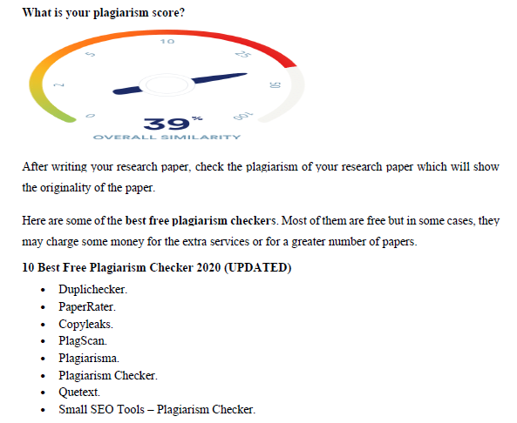
Research Paper Writing Steps

Slide 13
Research Paper Writing Steps
Step 3: Cite your sources correctly
Every time you quote or paraphrase, you must include an in-text or footnote citation clearly identifying the original author.
Each citation must correspond to a full reference in the reference list or bibliography at the end of your paper. This helps your readers locate the source for themselves if they would like to learn more.
There are many different citation styles, and each one has its own rules. A few of the most common styles are APA, MLA, and Chicago styles. Your instructor may assign a particular style for you to use, or perhaps you can choose. However, the most important thing is to apply one style consistently throughout the text.
Step 4: Check your work
Before submitting your paper, check it carefully for errors that might constitute accidental plagiarism. Common mistakes include:
• Forgotten or misplaced citations
• Missing quotation marks
• Paraphrased material that’s too similar to the original text
• Sources missing from the reference list

